Slide 1
Snowflake boot camp training

Slide 2
Snowflake and DATAWAREHOUSE
A data warehouse is a central repository of information that can be analyzed to make more informed decisions.
A data warehouse, or “enterprise data warehouse” (EDW), is a central repository system in which businesses store valuable information, such as customer and sales data, for analytics and reporting purposes
What is data warehouse in ETL?
Extract, transform, and load (ETL) is the process of combining data from multiple sources into a large, central repository called a data warehouse. ETL uses a set of business rules to clean and organize raw data and prepare it for storage, data analytics

Slide 3
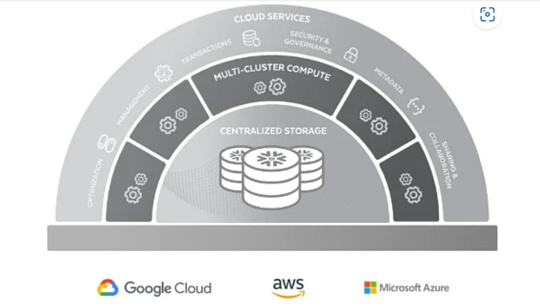
What is Snowflake?
Snowflake enables data storage, processing, and analytic solutions that are faster, easier to use, and far more flexible than traditional offerings. The Snowflake data platform is not built on any existing database technology or “big data” software platforms such as Hadoop.
A relational database stored in the cloud called snowflake is used to create data warehouses. It is constructed using the Google cloud platforms, Azure, and AWS and combines the features of conventional databases with a number of fresh and innovative options

Slide 4
Features of snowflake
Security, Governance, and Data Protection
User authentication based on the region (MFA,SSO, Snowflake AUTH, External AUTH)
Isolation of data (for loading and unloading) using:
Amazon S3 policy controls.
Azure storage access controls.
Google Cloud Storage access permissions.
Automatic Data Encryption
Object level access control
Fail - safe and Time Travel
Row and Column level security
Data types and functions
Tools and Interfaces (Snowsight, Snowsql, Snowflake Extension for VS code)

Slide 5
Features of snowflake
Apps and Extensibility
Connectivity
Data import and export
(Support for bulk loading and unloading data into/out of tables)
Data Sharing
Replication and Failover

Slide 6
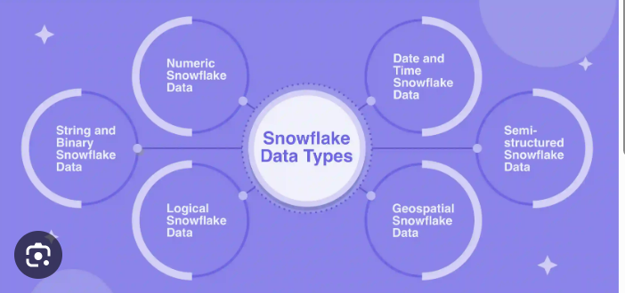
DATA types in snowflake Refer : Summary of Data Types | Snowflake Documentation

Slide 7
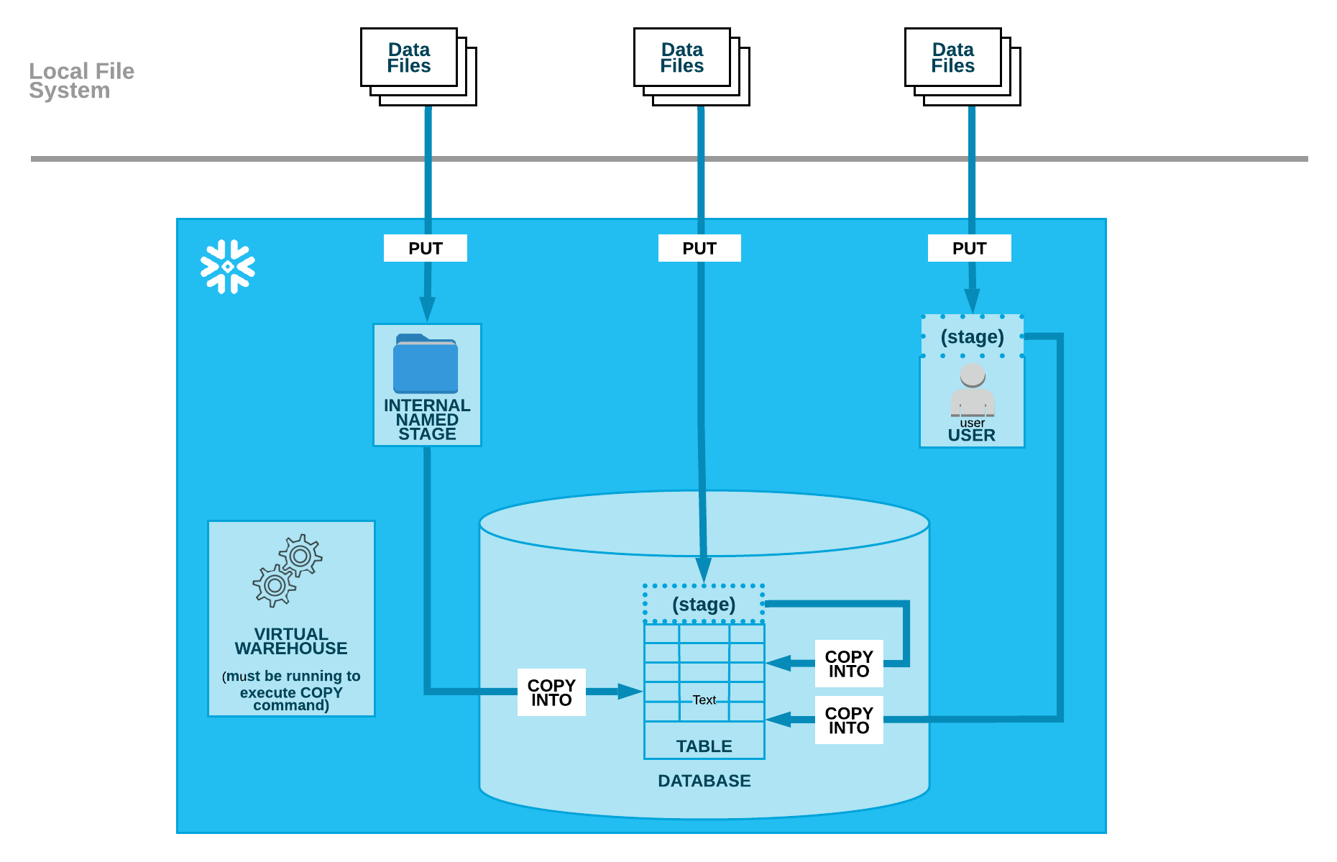
Loading data INTO SNOWFLAKE TABLE enables loading batches of data from files already available in cloud storage, or copying (i.e. staging) data files from a local machine to an internal (i.e. Snowflake) cloud storage location before loading the data into tables using the COPY command.
and

Slide 8
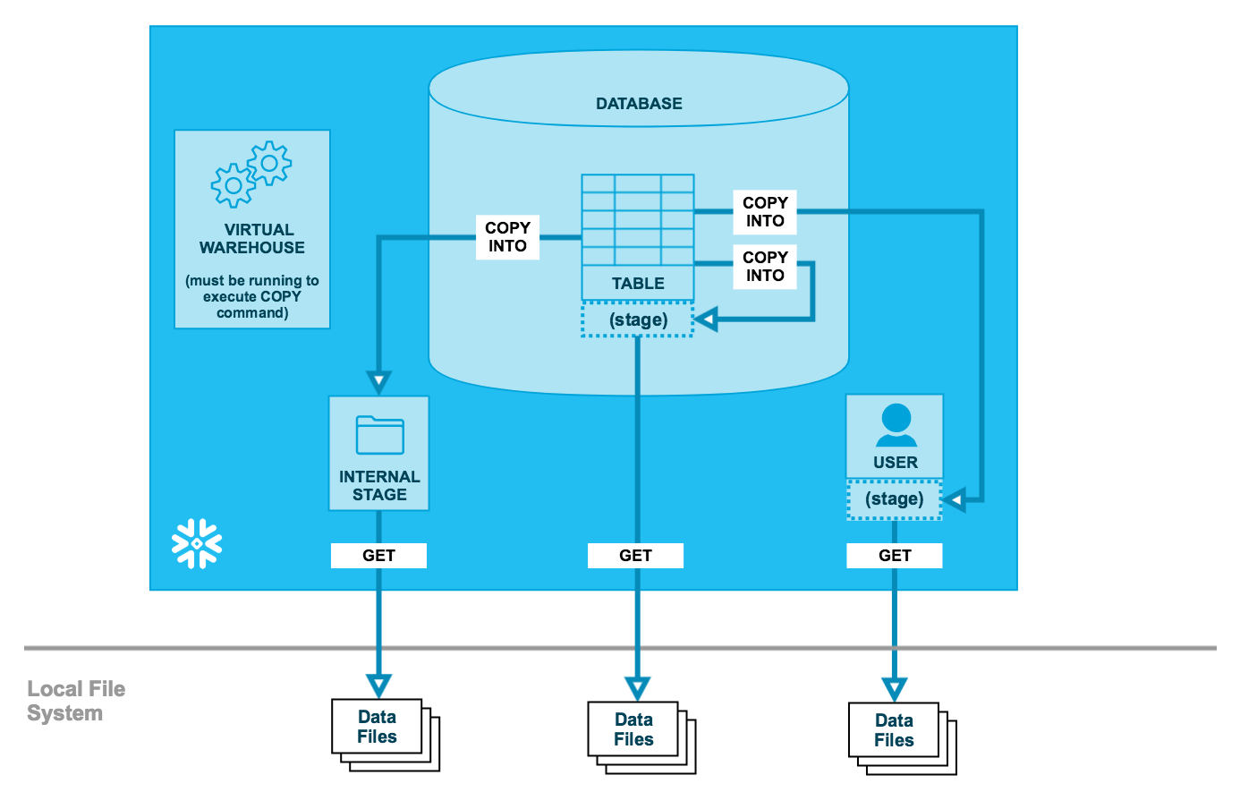
UNLOADING DATA FROM SNOWFLAKE TABLE TO STAGE (COPY INTO LOCATION,GET) Similar to data loading, Snowflake supports bulk export (i.e. unload) of data from a database table into flat, delimited text files.

Slide 9
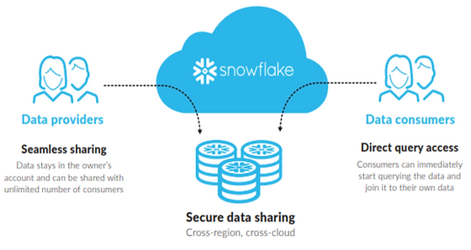
DATA SHARING (PROVIDERS AND CONSUMERS) RESTRICTIONS TO USERS AND ROLES WHILE SHARING THE DATA Snowflake enables the sharing of databases through shares, which are created by data providers and “imported” by data consumers. All database objects shared between accounts are read-only

Slide 10
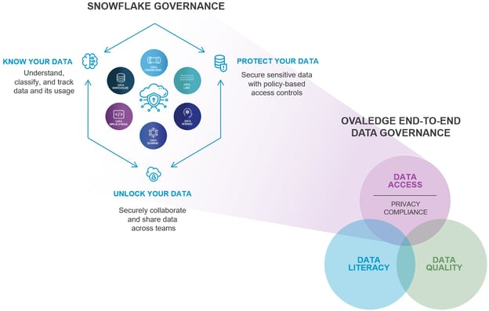
DATA PROTECTION and governance

Slide 11
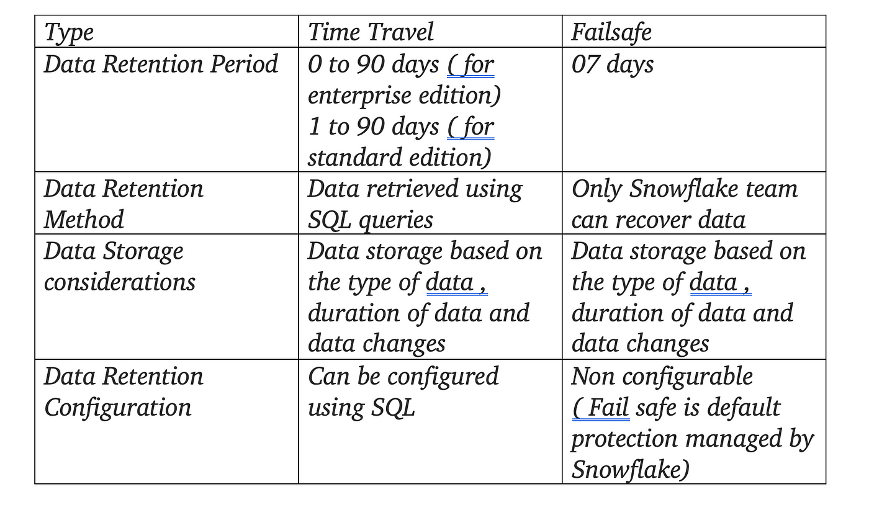
Fail safe and time travel Fail-safe provides a (non-configurable) 7-day period during which historical data may be recoverable by Snowflake. This period starts immediately after the Time Travel retention period ends. Snowflake Time Travel is a very important tool that allows users to access Historical Data (i.e. data that has been updated or removed) at any point in time in the past. It is a powerful Continuous Data Protection (CDP) feature that ensures the maintenance and availability of historical data.

Slide 12
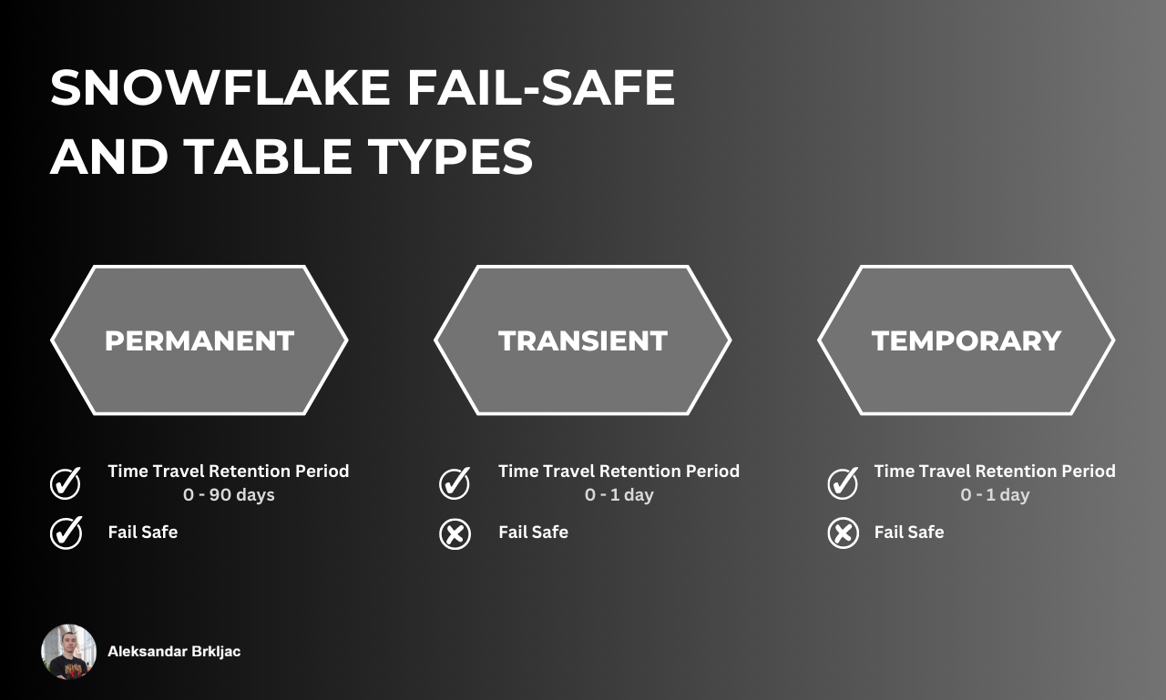
Fail safe and time travel

Slide 13
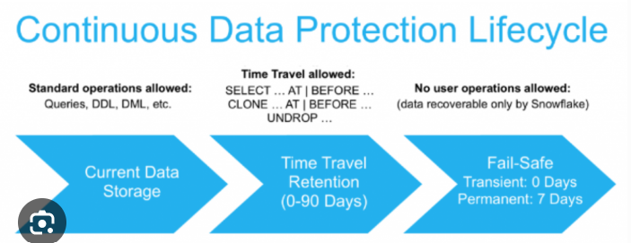
Fail safe and time travel

Slide 14
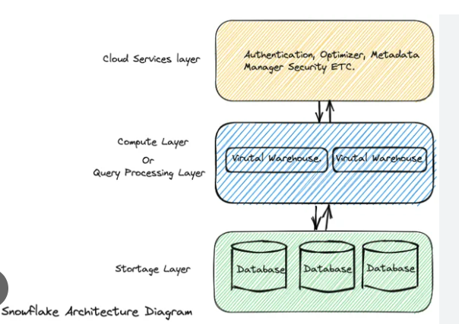
Three layers of snowflake

Slide 15
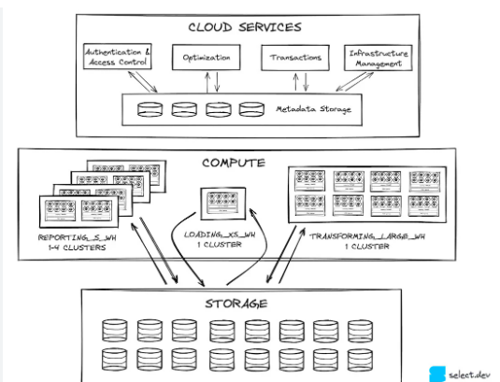
Three layers of snowflake

Slide 16
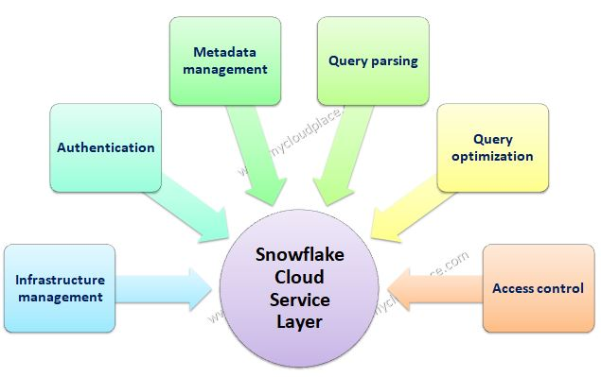
Cloud service layer

Slide 17
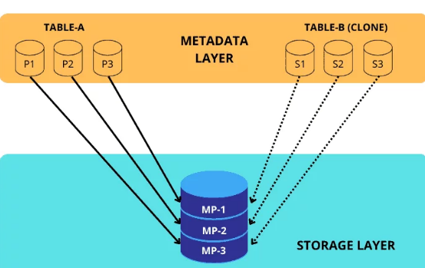
Cloning in snowflake
The term "Zero Copy Clone" is used because Snowflake's cloning process doesn't involve physical data copying. It creates a reference to the source data, eliminating the need for duplication and resulting in zero additional storage costs.

Slide 18
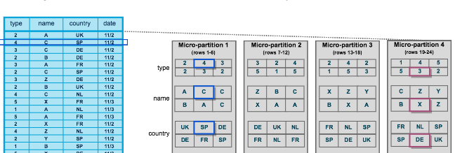
Micro partition and clustering in snowflake micro-partitions are contiguous units of data storage that Snowflake automatically stores data in by default. Whenever data is loaded into Snowflake tables, it automatically divides them into these micro-partitions

Slide 19
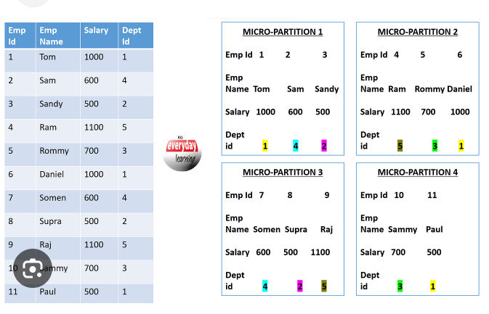
Clustering it is a technique employed in Snowflake tables to group related rows together within the same micro-partition, thereby enhancing query performance for accessing these rows.

Slide 20

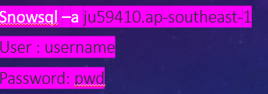
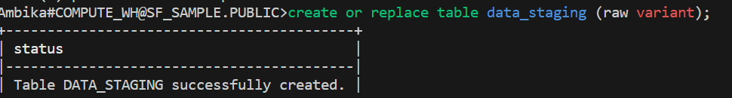
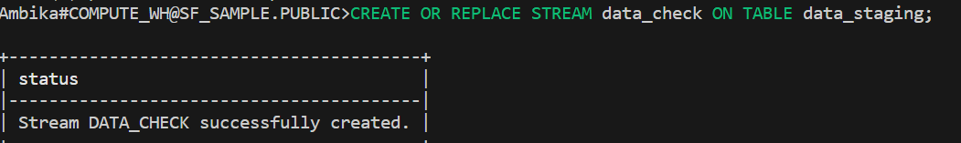
snowsql
Download and install snowsql in your local machine

Slide 21
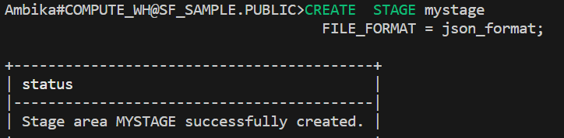
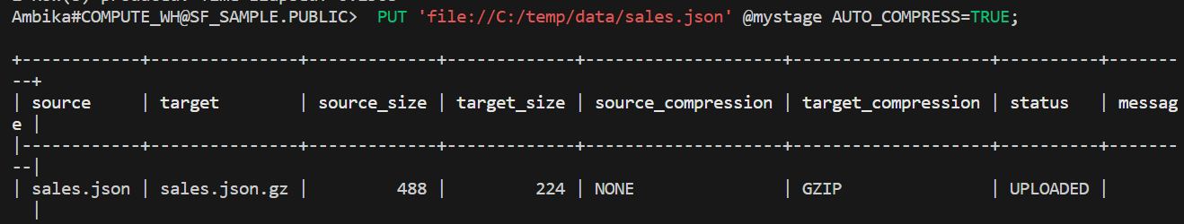
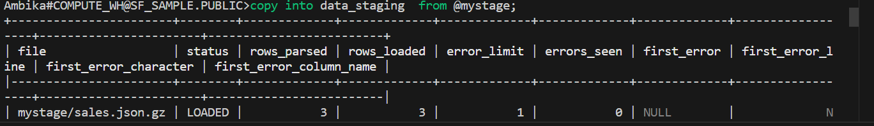
SNOWSQL

Slide 22
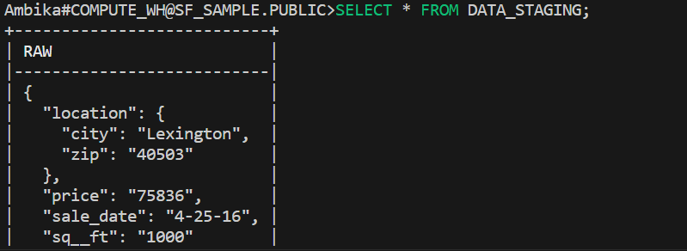
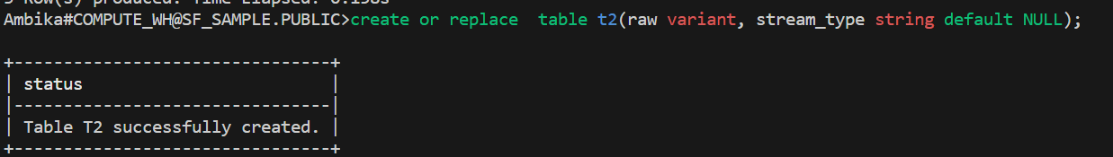
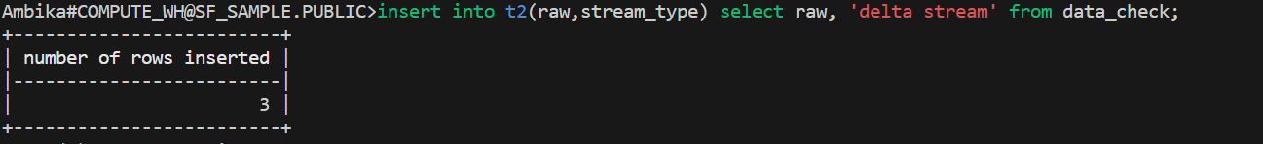
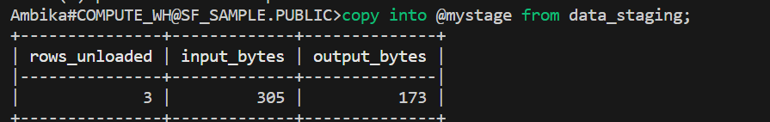
SNOWSQL

Slide 23
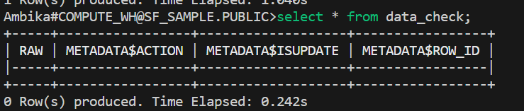
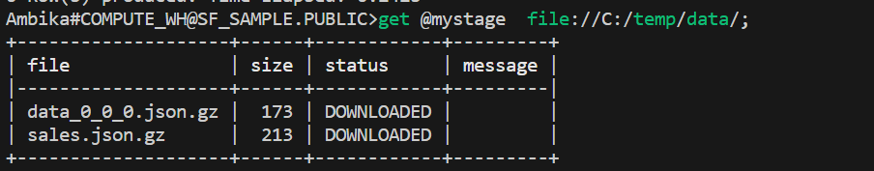
SNOWSQL
After unloading data from table to stage
Data in stream will be deleted
Unloaded data saves in a file in local drive

Slide 24
Sequence
CREATE OR REPLACE SEQUENCE seq_01 START = 1 INCREMENT = 1;
CREATE OR REPLACE TABLE sequence_test_table (i INTEGER);
INSERT INTO sequence_test_table (i) VALUES (seq_01.nextval);
ALTER SEQUENCE seq_01 RENAME TO myseq;
DROP SEQUENCE IF EXISTS myseqDESC SEQUENCE myseq

Slide 25
procedure
CREATE OR REPLACE PROCEDURE
return_greater(number_1 INTEGER, number_2 INTEGER)
RETURNS INTEGER NOT NULL
LANGUAGE SQL
AS BEGIN
IF (number_1 > number_2) THEN RETURN number_1;
ELSE RETURN number_2; END IF;END;
CALL return_greater(2, 3);

Slide 26
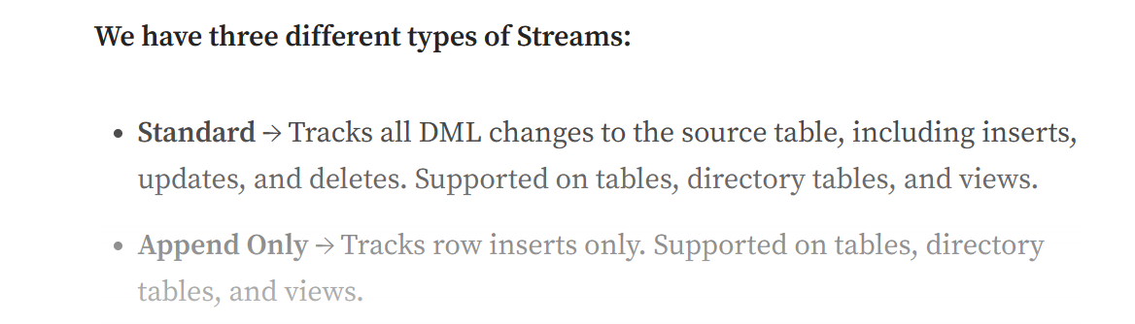
STREAMS
A stream records data manipulation language (DML) changes made to a table, directory table, external table, or the underlying tables in a view (including secure views). The object for which changes are recorded is called the source object.
In Insert only streams which is similar to append only except it operates more on external tables

Slide 27
STREAMS
create or replace stream delta_s on table t;
create or replace stream append_only_s on table t append_only=true;
insert into t values (0, 'charlie brown’);
insert into t values (1, 'lucy’);
insert into t values (2, 'linus’);
SELECT * FROM T
-- DELETE OPERATION (IT WONT DO DELETE OPERATION IN APPEND-ONLY)
delete from t where id = ‘0’; select * from delta_s order by id;
select * from append_only_s order by id;
-- UPDATE OPERATION ( IT WONT DO UPDATE OPERATION IN APPEND-ONLY)
update t set name = 'sally' where id = 2 -- Update a row in the source table.
select * from delta_s order by id;
select * from append_only_s order by id;

Slide 28
STREAMS
-- Create a table to store the change data capture records in each of the streams.create or replace table t2(id int, name string, stream_type string default NULL);
-- Insert the records from the streams into the new table, advancing the offset of each stream.insert into t2(id,name,stream_type) select id, name, 'delta stream' from delta_s;
Insert into t2(id,name,stream_type) select id, name, 'append_only stream' from append_only_s;

Slide 29
TASKS
A task can execute any one of the following types of SQL code:
Single SQL statement
Call to a stored procedure
Procedural logic using Snowflake Scripting

Slide 30
TASKS
select * from SF_SAMPLE.PUBLIC.T2
CREATE OR REPLACE TASK task1
SCHEDULE = 10 minutes
WHEN
SYSTEM$STREAM_HAS_DATA('data_check')
AS
insert into t2(raw,stream_type) select id, name, 'delta stream' from data_check;
execute task task1
select *
from table(information_schema.task_history())
order by scheduled_time;
select * from t2
select * from task1

